Slide 1
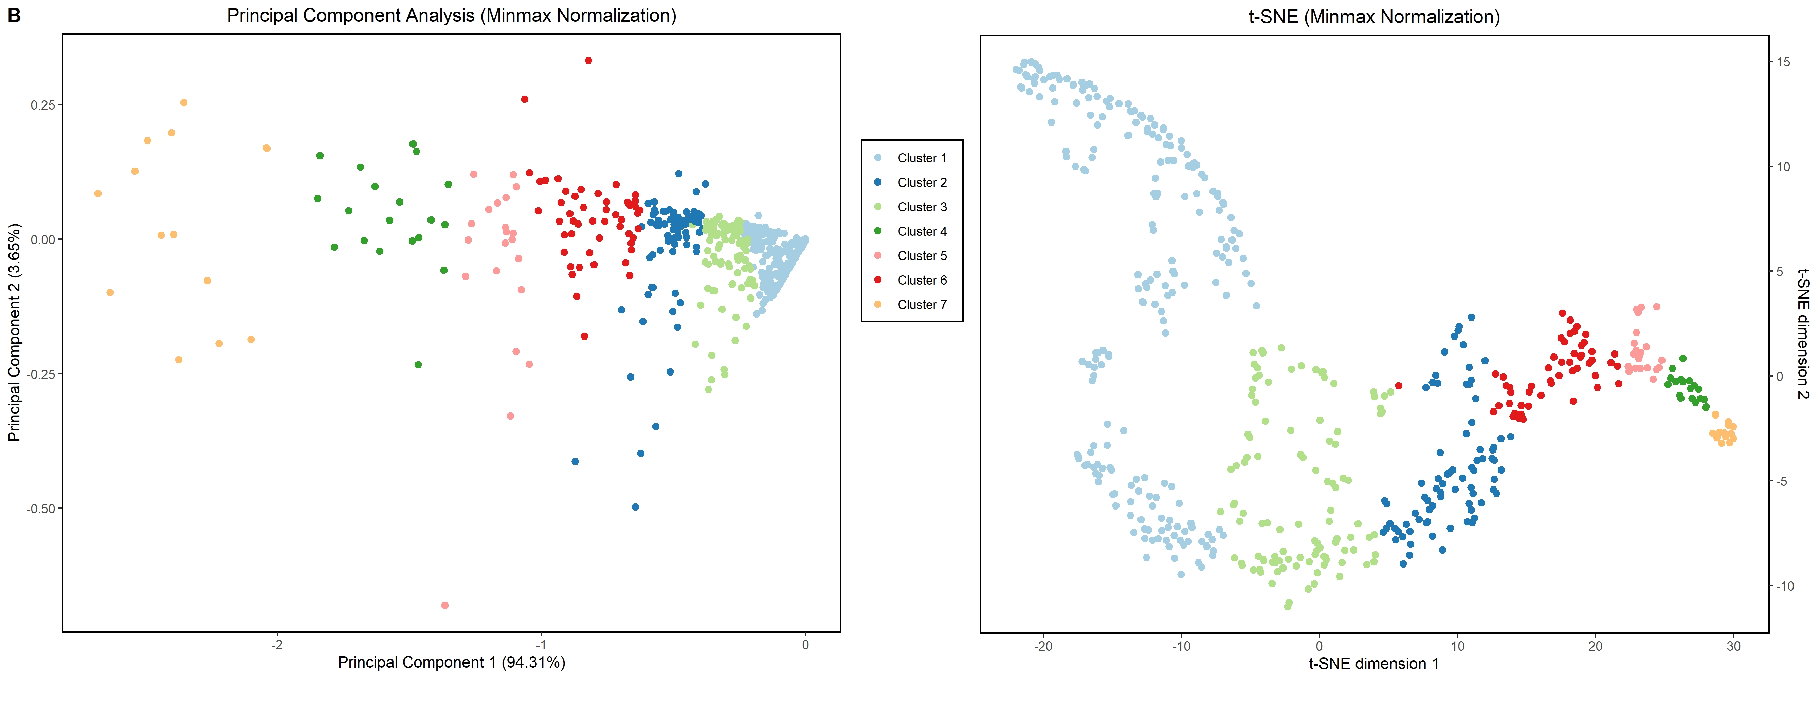
Cluster 1
216 businesses
28% audit success rate

